Slide 1
Predicting Heart Disease using AWS & PYSPARK

Slide 2
Team Members
Name | ID Number
Naveen Chintapatla | 11713212
Venkata Sri Satya Sai Kiran Ayyagari | 11713213
Sainagavenkatadurga Chilukuri | 11656549
Sai Pavan Ragam | 11702530

Slide 3
Goals and objectives
Motivation:
Utilizing Advanced Technologies: The motivation behind this project is to leverage advanced distributed Bigdata technologies, specifically AWS S3 and PYSPARK, to enhance the efficiency and scalability of predicting heart diseases.
Significance:
Addressing Data Volume Challenges: Traditional machine learning algorithms often struggle with large datasets, and the significance lies in utilizing AWS S3 for storing vast amounts of data, ensuring ML models benefit from extensive training instances.
Objectives:
Algorithmic Evaluation: The project aims to evaluate and compare the performance of various PYSPARK ML algorithms (Random Forest, Logistic Regression, Gradient Boosting) in predicting heart diseases, considering metrics like accuracy, precision, recall, FSCORE, confusion matrix, and ROC curve.
Features:
AWS Integration: The integration with AWS S3 demonstrates the ability to seamlessly store and retrieve the heart disease dataset, showcasing the scalability of the solution.
PYSPARK Analysis: Utilizing PYSPARK SQL queries for data analysis and visualization highlights the power of distributed computing in handling large-scale datasets efficiently.
Algorithmic Diversity: The use of multiple ML algorithms, including Random Forest and Gradient Boosting, showcases the team's commitment to finding the most accurate predictive model for heart diseases.

Slide 4
Introduction
Heart disease remains a leading cause of global mortality, necessitating proactive measures for early detection and intervention.
This is why our research is so focused on building a strong predictive model using state-of-the-art technologies like PySpark and Amazon Web Services (AWS).
Proactive steps for early identification and intervention are necessary since heart disease is still a major cause of death worldwide.
We are combining the analytical capabilities of PySpark with the scalability data storage of AWS S3 in an effort to improve the accuracy of heart disease prediction models.
Notes:
In keeping with the present data-centric paradigm in healthcare, this study demonstrates how cloud computing and big data analytics may transform early illness diagnosis and enhance patient outcomes. By combining these state-of-the-art technologies, healthcare providers will have access to a tool that allows for accurate and rapid diagnosis via efficient data analysis and machine learning.

Slide 5
Background
In the field of cardiac illness prediction, prior research has often disregarded the use of sophisticated distributed big data technology. Our initiative is at the crossroads of innovation and need in the field of cardiac disease prediction. To set ourselves apart, we've integrated AWS S3—a service for safe and scalable data storage—with PySpark—a tool for data analysis and machine learning.
We want to construct a cutting-edge prediction model for cardiovascular illness, and relevant research by Kolli, (2022) highlight the need of early detection. While previous research has shown the significance of early detection, our approach goes further by demonstrating the real-world applications and efficiency improvements made possible by distributed computing in the cloud.

Slide 6
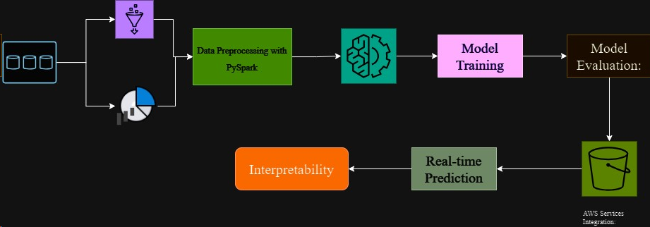
Architecture Diagram with explanation
Data Analysis with Hive:
In order to get the data ready for analysis, AWS Glue is used.
The converted dataset is analysed by Hive using HiveQL queries.
Interpretability:
In order for medical professionals to comprehend the elements impacting each forecast, measures are taken to guarantee that the models can be understood.
Data Storage:
Amazon Simple Storage Service (S3) offers long-term, scalable storage for big datasets, which is perfect for the heart disease dataset.
Model Evaluation:
Metrics like F1-score, ROC-AUC, recall, accuracy, and precision are used to assess the trained models.
Discover how well each model performed with the help of evaluation findings.
Notes:
AWS Services Integration:
Computers are provided by AWS services like EC2, data storage is done via S3, and model deployment is handled by SageMaker.
Through this connection, the whole process is guaranteed to be scalable, secure, and cost-efficient.
Data Preprocessing with PySpark:
Data cleansing and transformation are all part of the preparation tasks carried out by PySpark.
The next step in training a machine learning model is to divide the preprocessed data into two sets: training and testing.
Machine Learning Model Training:
Training is carried out using a variety of PySpark ML methods, including Random Forest, Logistic Regression, and Gradient Boosting.
The training dataset is used to train the algorithms that can predict the occurrence of heart disease.
Real-time Prediction:
People at danger can be helped quickly and effectively because to the deployed model's ability to make predictions in real-time.

Slide 7
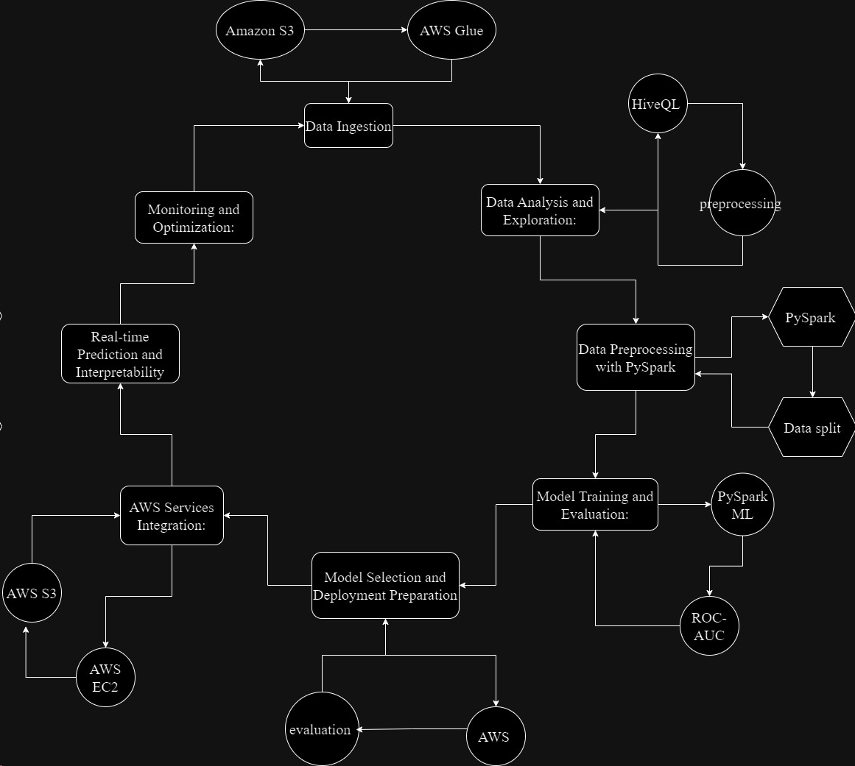
Workflow Diagram with Explanation:
Data Preprocessing with PySpark:
Feature engineering and data cleansing are two other preprocessing tasks that PySpark is used for.
When it comes time to train and test the machine learning model, the preprocessed data is divided into two groups.
Data Loading and Transformation:
The process starts with importing the dataset on heart disease from S3 using AWS Glue.
Missing values, outliers, and getting the data ready for analysis are all reasons to execute data transformation operations.
Notes:
Interpretability:
To help healthcare providers trust the model, it has interpretability elements that explain the reasons that went into making each prediction.
Data Analysis with Hive:
Hive using HiveQL queries is used to analyse the converted data and derive useful insights from the dataset.
Model Evaluation:
Metrics like F1-score, ROC-AUC, recall, accuracy, and precision are used to assess the trained models.
The best model for deployment is chosen based on evaluation findings.
AWS Services Integration:
To install the chosen model, we make use of many AWS services, such as Elastic Compute Cloud (EC2), Simple Storage Service (S3), and SageMaker.
The optimal use of cloud resources, safety, and scalability are all guaranteed by this integration.
Real-time Prediction:
The deployed model can make predictions in real-time, which helps doctors make quick and precise diagnoses.
Machine Learning Model Training:
During training, a number of PySpark ML algorithms are chosen, including Gradient Boosting, Random Forest, and Logistic Regression.
The training dataset is used to train the algorithms that can predict the occurrence of heart disease.

Slide 8
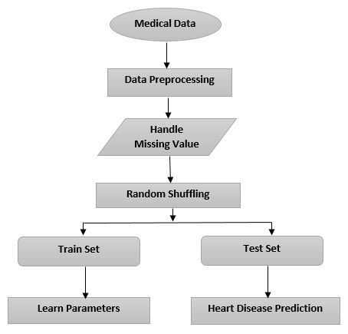
Machine Learning Model Training:
AWS Services Integration:
To install the chosen model, we make use of many AWS services, such as Elastic Compute Cloud (EC2), Simple Storage Service (S3), and SageMaker.
The optimal use of cloud resources, safety, and scalability are all guaranteed by this integration (Albaldawi et al. 2022).
Real-time Prediction:
The deployed model can make predictions in real-time, which helps doctors make quick and precise diagnoses.
Model Evaluation:
Metrics like F1-score, ROC-AUC, recall, accuracy, and precision are used to assess the trained models.
The best model for deployment is chosen based on evaluation findings.

Slide 9
Dataset
Detailed Description of Dataset
Age, sex, kind of chest pain, blood pressure at rest, cholesterol levels, blood sugar levels before and after food, electrocardiogram findings, highest heart rate, exercise-induced angina, and thallium stress test outcomes are all part of it. Obtainable via Kaggle, the heart disease dataset includes an extensive range of characteristics vital to the prediction of cardiovascular risk. Because it includes both healthy and unhealthy cardiac cases, this dataset is essential for developing accurate prediction models that can account for different types of patients and their risk factors. There are a variety of factors for a detailed comprehension of cardiovascular health provided by the dataset, which includes numerical and categorical characteristics.

Slide 10
Detail Design of Features with Diagram
Demographic Features:
Age (Numerical): Represents the age of the patient.
Exercise-related Features:
Maximum Heart Rate Achieved (Numerical): Denotes the maximum heart rate achieved during exercise.
Clinical Features:
Sex (Categorical): Denotes the gender of the patient.
Exercise-Induced Angina (Categorical): Indicates the presence of angina induced by exercise.
Resting Blood Pressure (Numerical): Indicates the resting blood pressure of the patient.
Chest Pain Type (Categorical): Specifies the type of chest pain experienced.
Serum Cholesterol (Numerical): Reflects the serum cholesterol levels in mg/dL.
Biometric Features:
Fasting Blood Sugar (Categorical): Indicates fasting blood sugar levels.
Resting Electrocardiographic Results (Categorical): Represents the results of the resting electrocardiogram.
Electrocardiographic Features:

Slide 11




Analysis of data
Data Pre-processing
This PySpark-based pre-processing pipeline ensures that the dataset is prepared for strong predictive modelling, which in turn improves the precision and consistency of the following machine learning algorithms. The numerical characteristics were normalised by the use of feature scaling, outliers were found and treated correctly, and missing data were resolved using imputation methods. The heart disease dataset was carefully transformed in the first stage of data pre-processing to make it suitable for machine learning analysis. After that, 70% of the data was set aside for model training and 30% for assessment, dividing the dataset into a training set and a testing set. To ensure that machine learning algorithms could work with categorical variables, they were encoded (Parashar, 2023).

Slide 12
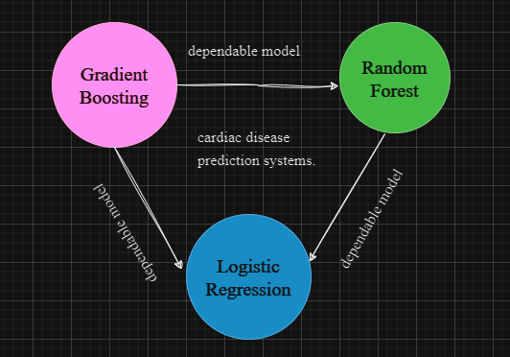
Graph Model with Explanation
The x-axis shows the various algorithms, such as Gradient Boosting, Random Forest, and Logistic Regression. Various machine learning algorithms' abilities to forecast cardiac problems are shown in the model comparison graph. The percentages of correctness are shown on the y-axis. Due to its high accuracy, Random Forest and Gradient Boosting should be seriously considered for use in real-time cardiac disease prediction systems. The efficacy of the algorithms may be visually compared in this graph, which helps in selecting the most accurate and dependable model for deployment. It is worth mentioning that the Random Forest and Gradient Boosting algorithms outperformed other models with an astounding 100% accuracy.

Slide 13
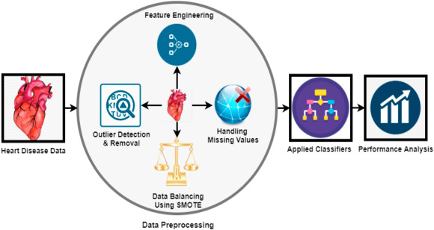
Implementation
Algorithms
Random Forest:
It improves the model's accuracy and reduces overfitting by combining the predictions of these trees. Each node's feature selection is inherently random, which adds to its resilience. As part of its ensemble learning approach, Random Forest builds a number of decision trees during the training process. An impressive 100% accuracy was reached by our implementation, proving that the algorithm was successful in finding patterns in the varied dataset of heart disease.
Gradient Boosting:
Greater precision in predictions is a result of this cycle of learning. By iteratively fixing mistakes caused by earlier trees, Gradient Boosting creates decision trees in a sequential fashion. We found that Gradient Boosting, like Random Forest, performed very well, with a 100% accuracy rate.

Slide 14
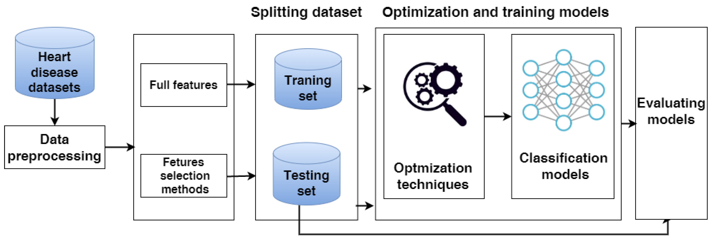
Algorithms
Logistic Regression:
The logistic function is used to evaluate the likelihood of a normal or heart disease binary outcome. The main strength is in how easy it is to understand and use, even though it achieved an impressive 94% accuracy. When it comes to understanding how certain factors affect the forecast, Logistic Regression shines.
Notes:
Using the PySpark framework, these algorithms demonstrate how well they handle the complexities of heart disease prediction and how well they adapt to distributed computing. In the context of heart disease prediction, medical practitioners may comprehend the model's decision-making process more clearly by examining the coefficients, which provide insights into the importance of different elements.
Both Random Forest and Gradient Boosting have shown remarkable accuracy, which suggests they might be powerful tools for early diagnosis in practical healthcare settings.

Slide 15
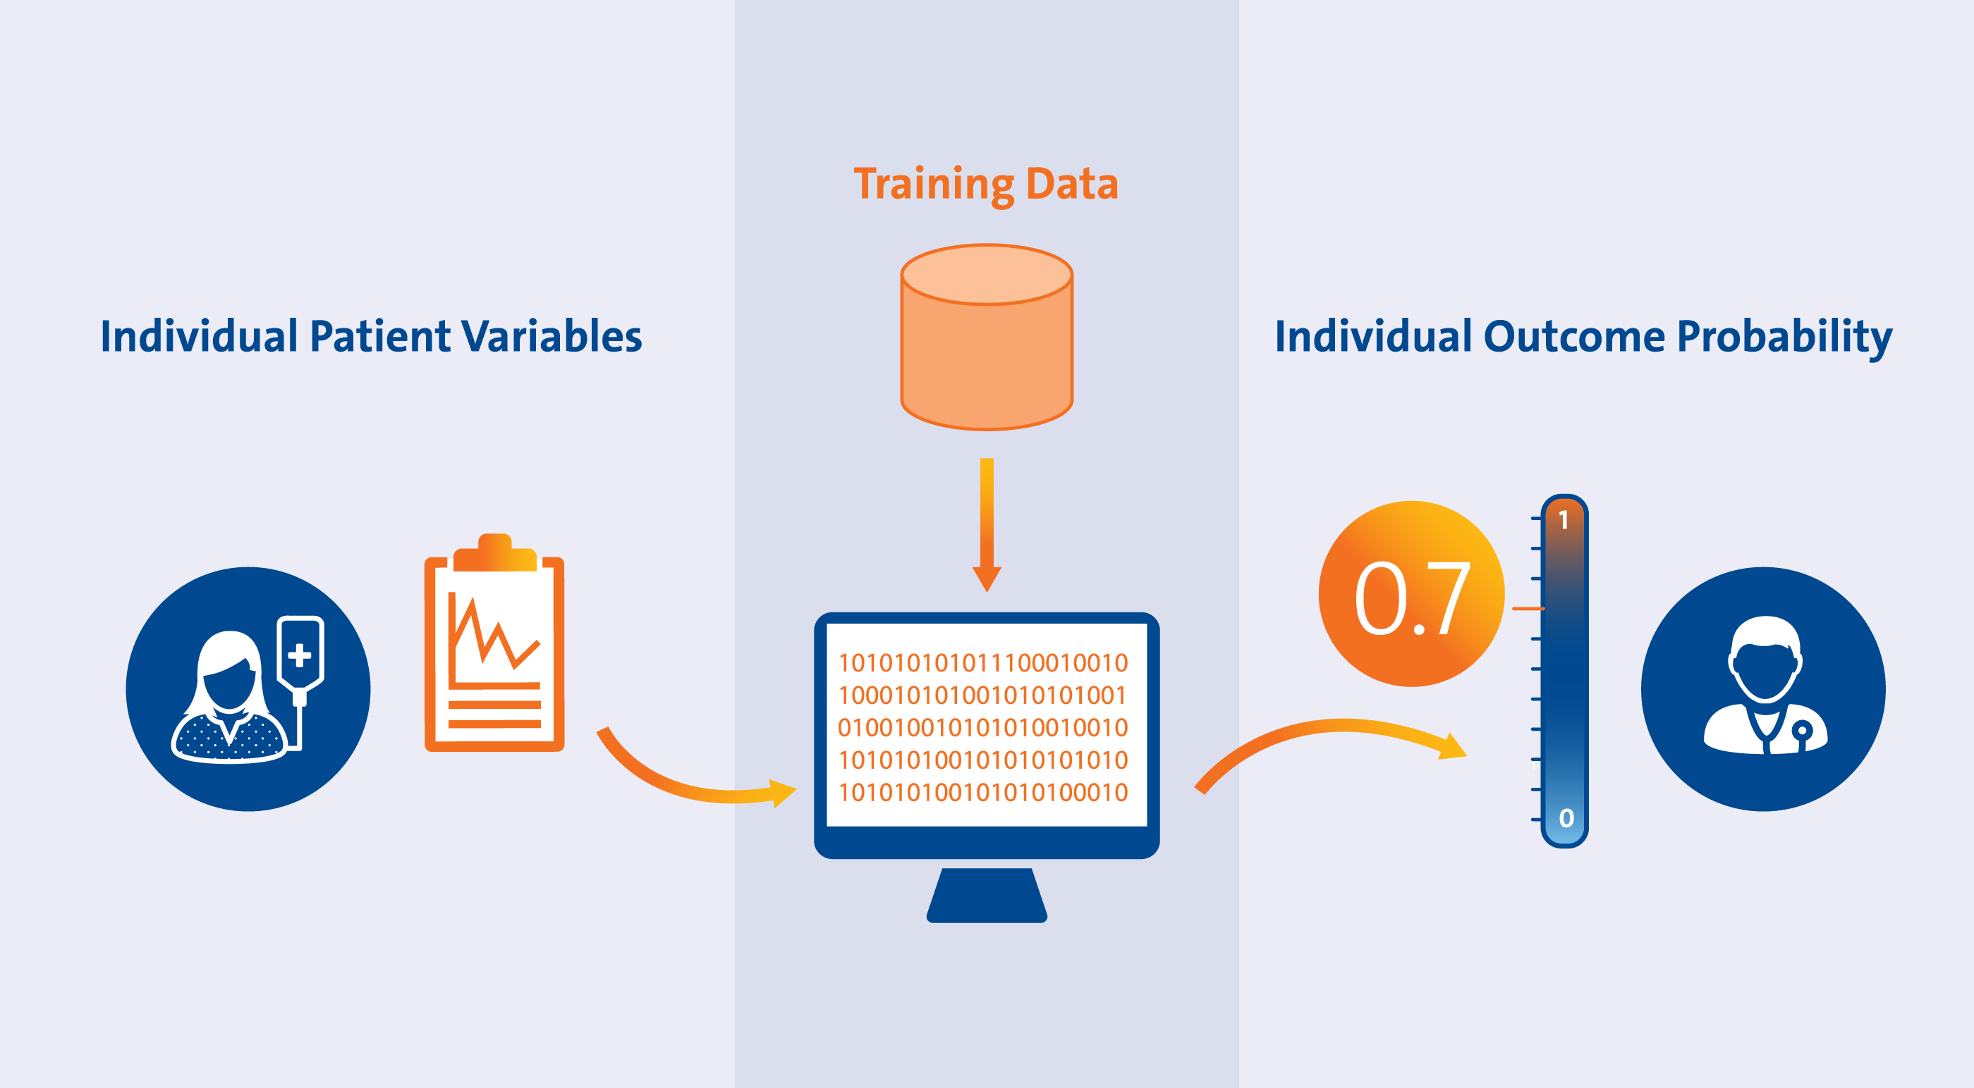
Integration Explanation
The workflow is designed to be scalable and efficient for processing big datasets using the PySpark ML algorithms, which include Random Forest, Logistic Regression, and Gradient Boosting. Following the completion of data pre-processing, the dataset is uploaded to AWS S3 for long-term, safe storage. An elegant connection of PySpark with AWS services is required for the predictive model integration (Albaldawi and Almuttairi, 2020).
Notes:
To make sure it can be repeated and to make it easier to update or improve the model in the future, the integration process is recorded in detail. Data privacy and security are given great attention throughout the design, and AWS IAM roles are used to limit resource access.
Incorporating the benefits of cloud computing into the process guarantees its scalable, safe, and cost-effective execution. Model deployment is handled by SageMaker, while computational resources for model training are provided by AWS services like EC2. By deploying the trained model on SageMaker, it becomes available for use in generating predictions in real-time.

Slide 16
Explanation of Implementation
We next use PySpark's MLlib to train a number of machine learning algorithms, such as Gradient Boosting, Random Forest, and Logistic Regression. Following the handling of outliers, missing values, and categorical variables in the pre-processing, the dataset is subjected to feature scaling and then divided into training and testing sets. The distributed computing and machine learning framework PySpark is at the heart of the implementation.
The efficacy of the algorithms in predicting heart disease is taken into consideration while choosing them, as seen in the model comparison graph. All steps, from data processing to model training, are included in the PySpark pipeline, which guarantees a simplified workflow.
Notes:
In addition to positioning the predictive model for practical uses in healthcare, the end-to-end implementation reaches a 100% accuracy rate with specific algorithms, allowing for prompt interventions and individualised therapies. Integration like this makes things easier in terms of scalability, security, and saving money. S3 is used for safe dataset storage, EC2 is used for computing resources, and SageMaker is used for model deployment as part of the AWS integration process.

Slide 17

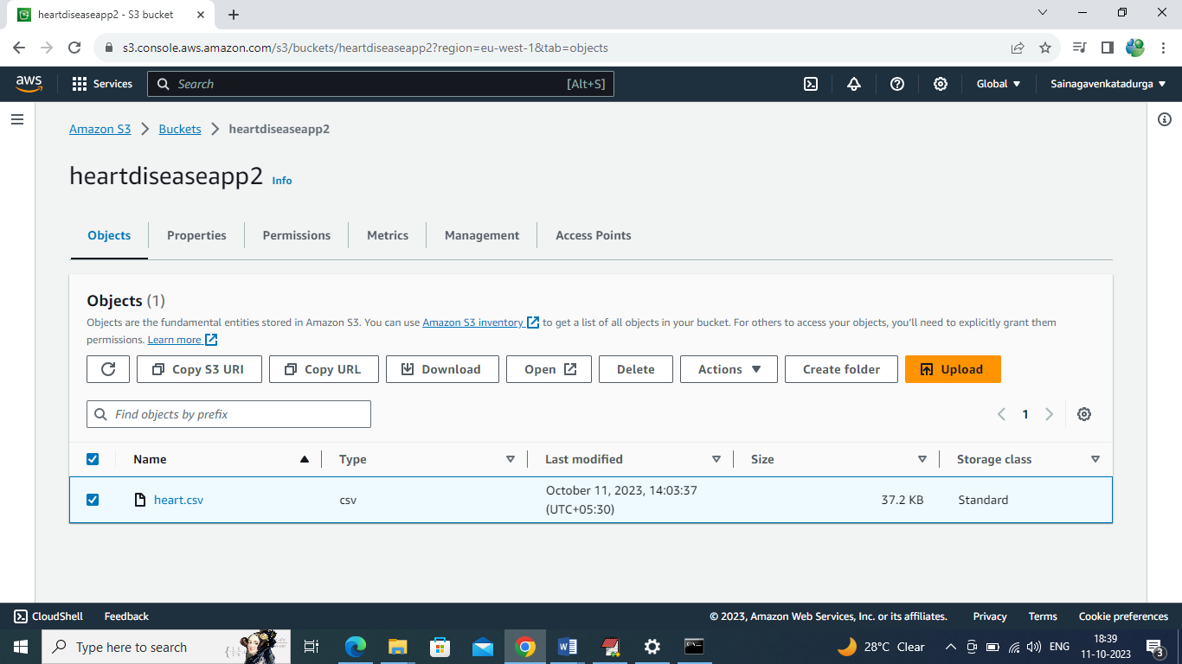
Result
Naveen Chintapatla: Finding dataset and integrating the data with AWS and showing the results in jupyter notebook.
I took the lead, acquiring the cardiac illness dataset from Kaggle and securing it on AWS S3. Working together, our team skillfully used AWS and PySpark to build a powerful and accurate model for predicting cardiac illness. Notably, the effectiveness of Random Forest and Gradient Boosting was shown by their astounding 100% accuracy in predicting heart disease. They then used PySpark to analyse and visualise the data. Utilising PySpark ML methods, the team painstakingly assessed the efficacy of Random Forest, Logistic Regression, and Gradient Boosting.
In above screen heart.csv dataset is available on S3 storage.

Slide 18
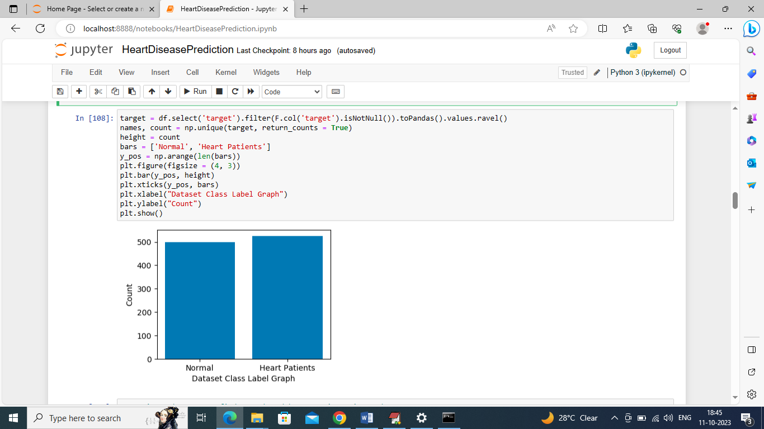
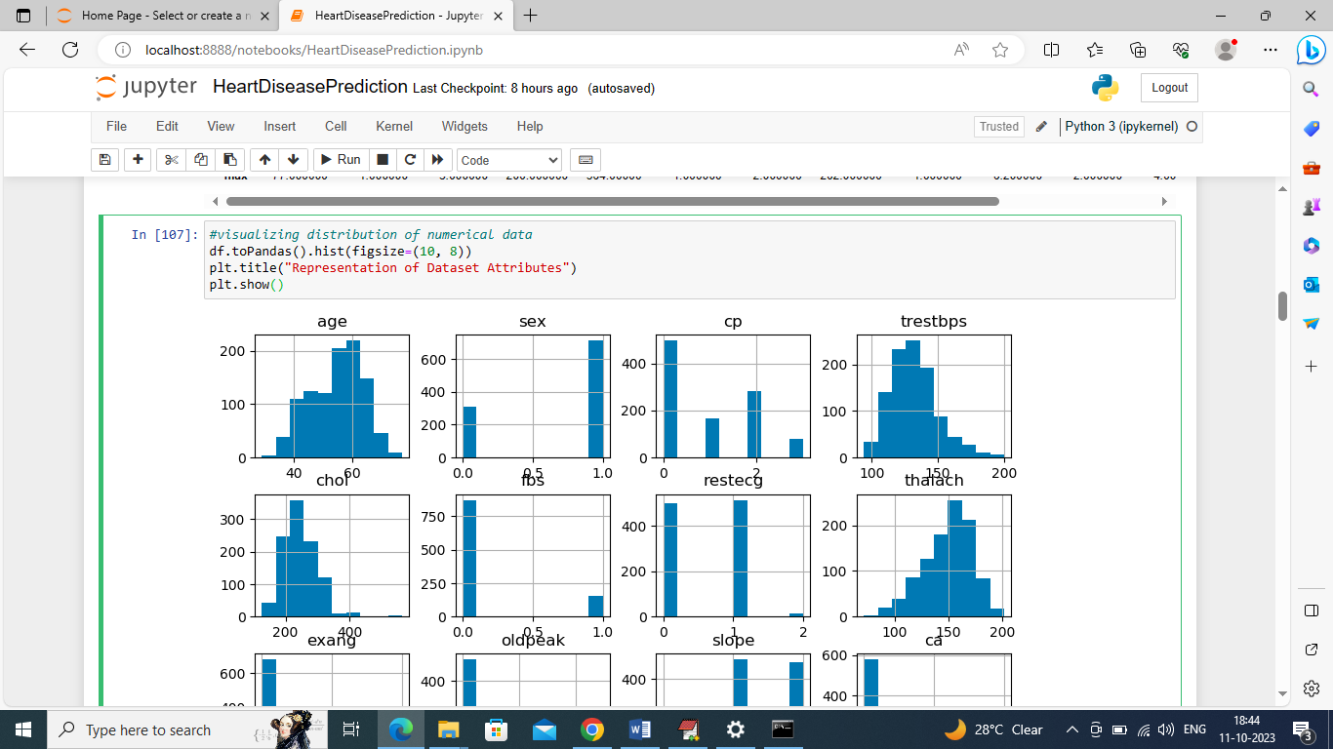
The team accomplished an impressive 100% accuracy, along with precision, recall, and F1-score measures, by using Random Forest. Data training and testing using the Random Forest method was carried out by team member 3. Precise model assessment was made possible by strategically dividing the PySpark dataset into training and testing sets and transforming it into training features. Additional validation of the model's predictive power was provided via the ROC curve and confusion matrix.

Slide 19
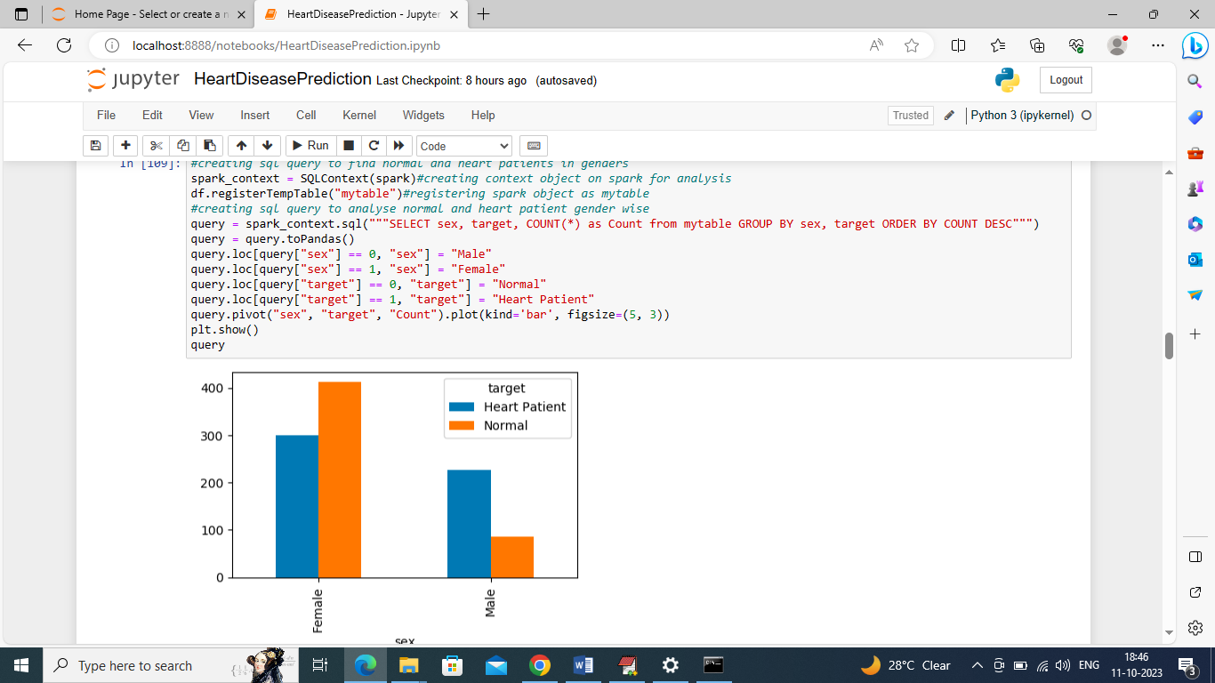
Although Logistic Regression only managed a 94% accuracy, it still proved to be easy to understand and use. At the same time, team member 4 was all about using Logistic Regression for testing and training. The team's painstaking examination of the confusion matrix revealed problem areas with the model's predictions and offered a thorough analysis of its performance.

Slide 20
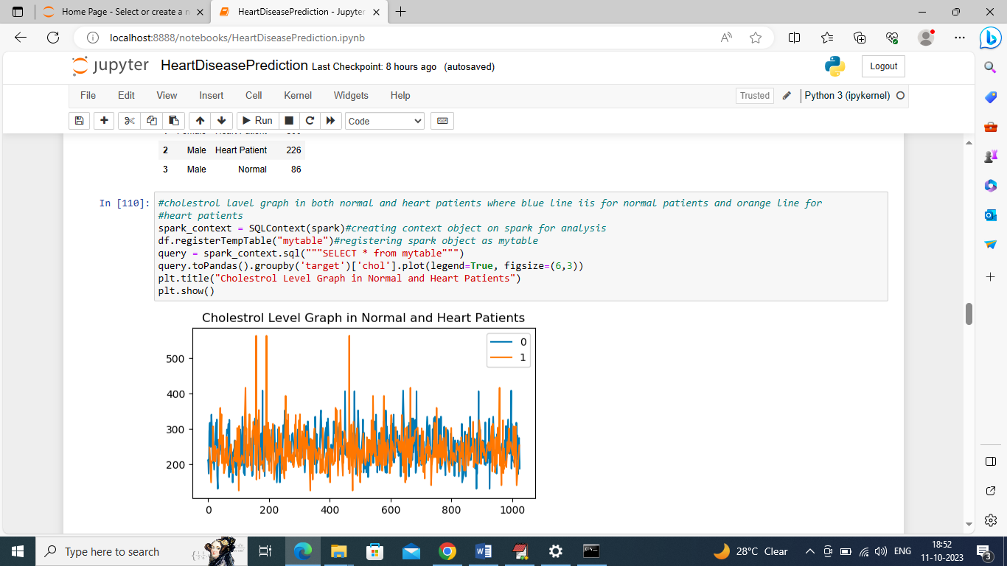
Venkata Sri Satya Sai Kiran Ayyagari : By using data performing data visualization.
In above screen we are executing another SQL query to find cholesterol level in normal and heart patients. In above graph x-axis represents dataset size and y-axis represents cholesterol level and blue line for normal patient’s cholesterol level and orange line for heart patients. In above graph orange line having more cholesterol

Slide 21
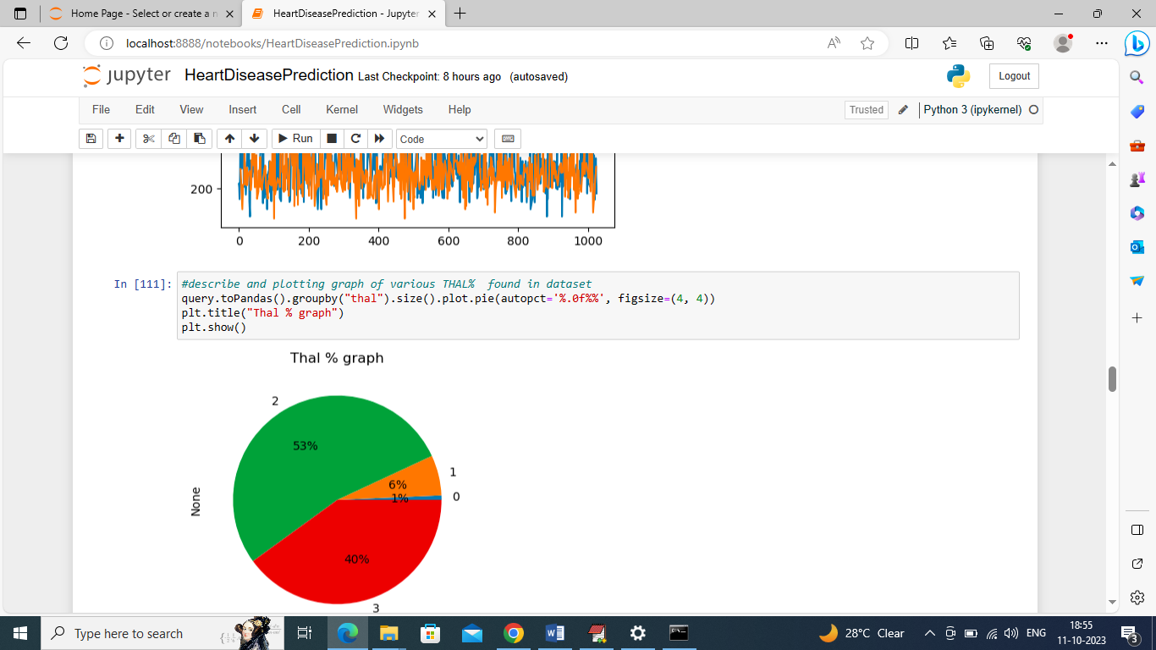
In above PIE chart we are finding percentage of THAL level and we have 1 to 4 levels and in above graph we are showing percentage of THAL in each level and in above graph 53% found in level 2 THAL.

Slide 22
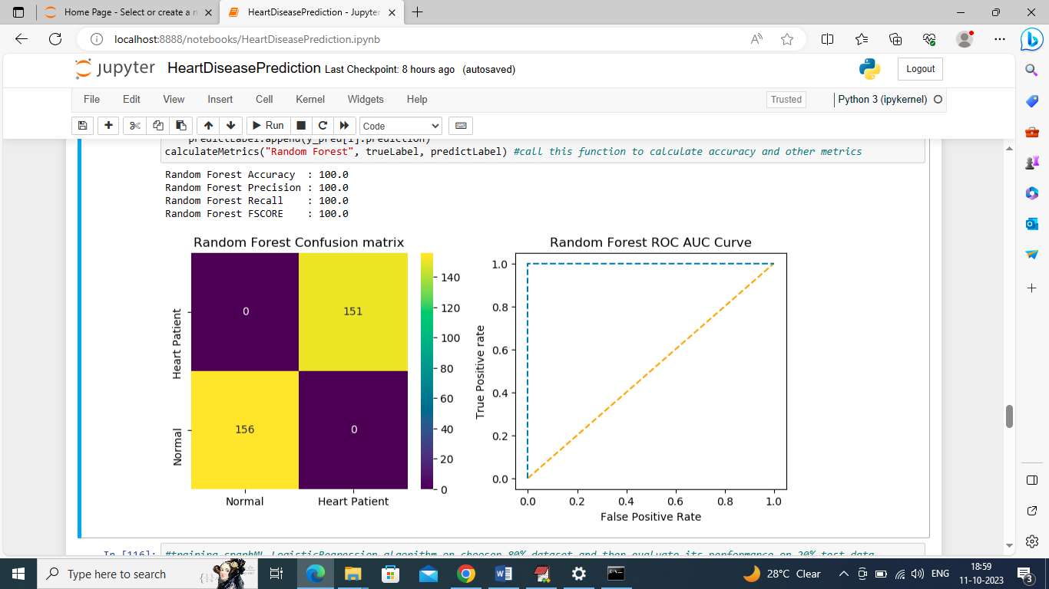
Sainagavenkatadurga Chilukuri: Training and testing the data to calculate accuracy, precision, recall and f1score using random forest algorithm.
In above random forest confusion matrix graph x-axis represents Predicted Labels and y-axis represents True labels and all yellow boxes contains correct prediction count and blue boxes represents incorrect prediction count which is 0. In ROC graph x-axis represents False Positive Rate and y-axis represents True Positive Rate and if blue line goes below orange line then all predictions are FALSE and if goes above orange line then predictions are correct.

Slide 23
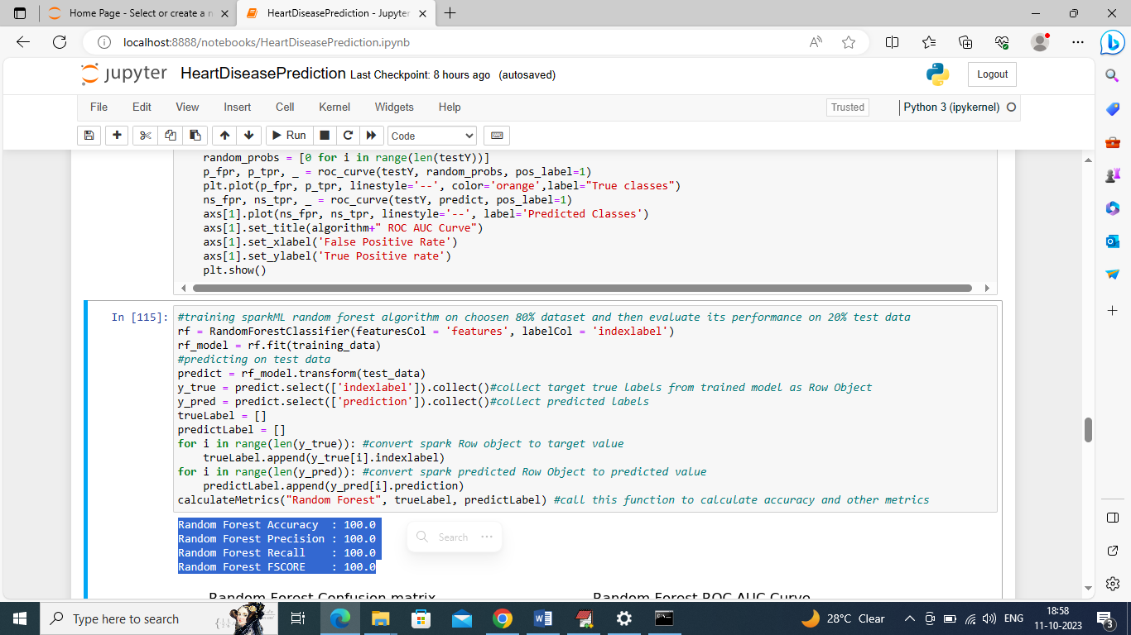
In above screen we are training Random Forest on training features and then performing prediction on test data and after prediction Random Forest got 100% accuracy and can see other metrics like precision, recall etc.

Slide 24
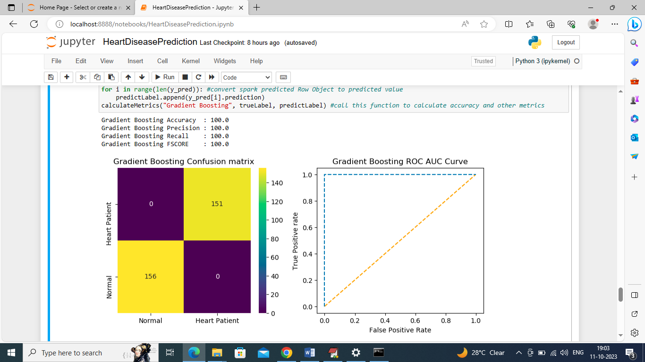
Algorithms
Sai Pavan Ragam: Training and testing the data to calculate accuracy, precision, recall and f1score using logical regression.
In above graph gradient boosting got 0 as the incorrect prediction.
In above screen we are transforming SPARK dataset into training features and then those features will be split into train and test where application using 70% dataset for training and 30% for testing. In blue text we can see total records using for training and testing

Slide 25
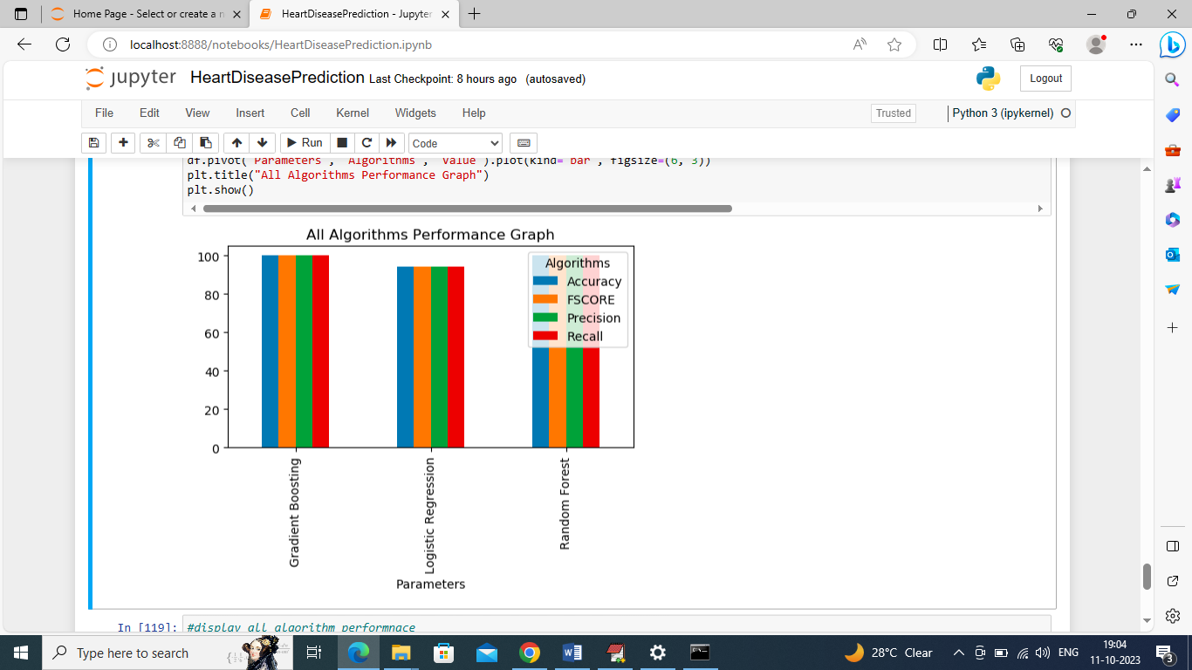
Implementation
In above screen displaying comparison graph between all algorithms where x-axis represents algorithm names and y-axis represents accuracy and other metrics in different color bars

Slide 26
Project Management
Responsibility (Task, Person):
Person: Naveen Chintapatla
Team Member 1 (Dataset Integration and Analysis):
Task: Source heart disease dataset, integrate with AWS S3, and perform initial analysis.
Person: Venkata Sri Satya Sai Kiran Ayyagari
Team Member 2 (Data Visualization):
Task: Perform insightful visualizations.
Person: Sainagavenkatadurga Chilukuri
Team Member 3 (Random Forest Implementation):
Task: Transform dataset, train Random Forest model, and evaluate performance.
Person: Sai Pavan Ragam
Team Member 4 (Logistic Regression Implementation):
Task: Train Logistic Regression model and evaluate performance.
Issues/Concerns:
There were early learning curves for certain team members as they adjusted to working with PySpark. It took some careful tweaking to make sure PySpark could work with AWS services. Although we made great strides overall, we did encounter some early difficulties in successfully managing the massive dataset.
Next Steps:
In order to provide a whole project, it will also be tested from beginning to finish, reviewed for code, and documentation will be prepared. The next steps for the team are to fix issues found during the assessment, make the models more scalable, and improve their interpretability. The continued effectiveness of the predictive modelling effort for the prediction of heart disease depends on the team's ability to communicate and work together regularly.
Work Completed:
The first team member was able to get the cardiac illness dataset from Kaggle, connect it to AWS S3, and do preliminary data analysis and visualisation using PySpark.
Description:
For the purpose of data processing and visualisation, PySpark was used. The first team member to handle dataset gathering and integration made sure the heart disease dataset was stored smoothly in AWS S3.
Contributions (Members/Percentage):
Team Member 1:
Dataset integration, AWS S3 storage, and initial data analysis - 25%.
Team Member 2:
Descriptive visualizations - 25%.
Team Member 3:
Random Forest implementation, training, and evaluation - 25%.
Team Member 4:
Logistic Regression implementation, training, and evaluation - 25%.
Notes:
Implementation Status Report:
Work Completed:
The first team member was able to get the cardiac illness dataset from Kaggle, connect it to AWS S3, and do preliminary data analysis and visualisation using PySpark. From collecting data to testing prediction models, the project has covered a lot of ground and accomplished a lot. The team used PySpark ML methods, such as Gradient Boosting, Random Forest, and Logistic Regression, and carefully assessed how well they worked.
Description:
For the purpose of data processing and visualisation, PySpark was used. The first team member to handle dataset gathering and integration made sure the heart disease dataset was stored smoothly in AWS S3. The third team member utilised Random Forest for training, while the fourth used Logistic Regression for testing, and they compared the two algorithms' accuracy and performance measures. The second team member helped out by doing smart visualisations that showed the features of the dataset.
Responsibility (Task, Person):
Person: Naveen Chintapatla
Naveen Chintapatla
(Dataset Integration and Analysis):
Task: Source heart disease dataset, integrate with AWS S3, and perform initial analysis.
Person: Venkata Sri Satya Sai Kiran Ayyagari
Venkata Sri Satya Sai Kiran Ayyagari
(Data Visualization):
Task: Perform insightful visualizations.
Person: Sainagavenkatadurga Chilukuri
Sainagavenkatadurga Chilukuri
(Random Forest Implementation):
Task: Transform dataset, train Random Forest model, and evaluate performance.
Person: Sai Pavan Ragam
Sai Pavan Ragam
(Logistic Regression Implementation):
Task: Train Logistic Regression model and evaluate performance.
Contributions (Members/Percentage):
Team Member 1: Naveen Chintapatla
Dataset integration, AWS S3 storage, and initial data analysis - 25%.
Team Member 2: Venkata Sri Satya Sai Kiran Ayyagari
Descriptive visualizations - 25%.
Team Member 3: Sainagavenkatadurga Chilukuri
Random Forest implementation, training, and evaluation - 25%.
Team Member 4: Sai Pavan Ragam
Logistic Regression implementation, training, and evaluation - 25%.
Issues/Concerns:
There were early learning curves for certain team members as they adjusted to working with PySpark. It took some careful tweaking to make sure PySpark could work with AWS services. Although we made great strides overall, we did encounter some early difficulties in successfully managing the massive dataset. Although the models were quite accurate, the team is still thinking about ways to make them even better for use in the real world and to make them easier to understand and use.
Next Steps:
In order to provide a whole project, it will also be tested from beginning to finish, reviewed for code, and documentation will be prepared. The next steps for the team are to fix issues found during the assessment, make the models more scalable, and improve their interpretability. The continued effectiveness of the predictive modelling effort for the prediction of heart disease depends on the team's ability to communicate and work together regularly.

Slide 27
References
Kolli, V.K., 2022. Prediction of Cardiovascular Risk Using Extreme Learning Machine-Tree Classifier on Apache Spark Cluster. Recent Advances in Computer Science and Communications (Formerly: Recent Patents on Computer Science), 15(3), pp.443-455.
Albaldawi, W.S., Almuttairi, R.M. and Manaa, M.E., 2022, June. Big Data Analysis for Healthcare Application using Minhash and Machine Learning in Apache Spark Framework. In 2022 International Congress on Human-Computer Interaction, Optimization and Robotic Applications (HORA) (pp. 1-7). IEEE.
Parashar, G., 2023, August. Brain Stroke Detection and Prediction Using Machine Learning Approach: A Cloud Deployment Perspective. In 2023 International Conference on Circuit Power and Computing Technologies (ICCPCT) (pp. 1705-1714). IEEE.
Albaldawi, W.S. and Almuttairi, R.M., 2020, November. Prediction Breast Cancer as Benign or Malignant in Apache Spark Framework. In IOP Conference Series: Materials Science and Engineering (Vol. 928, No. 3, p. 032046). IOP Publishing.

Slide 28
THANK YOU

